Slide 1
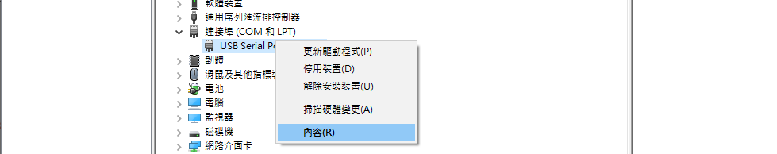
改變COM PORT的Latency Time

Slide 2
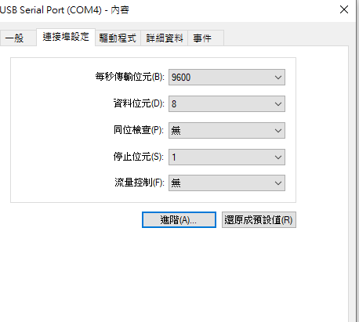

Slide 3

Latency 改為1
用程式方式去設定Latency請參考此份PPT: LabVIEW Set FTDI LatencyTimer說明.pptx

